Slide 1

Scalable Machine Learning
For Smarter Applications

Slide 2
Who am I?
Hank Roark (hank@h2oai.com, @hankroark)
Data Scientist & Hacker @ H2O.ai
Lecturer in Systems Thinking, UIUC
13 years at John Deere doing Research, New Product Development, New High Tech Ventures
Previously at startups and consulting
Physics Georgia Tech Systems Design & Management MIT

Slide 3

H2O.ai Overview
Founded: 2011 venture-backed, debuted in 2012
Product: H2O open source in-memory prediction engine
Team: 37 - Distributed Systems Engineers doing ML
HQ: Mountain View, CA
H₂O.ai Machine Intelligence

Slide 4



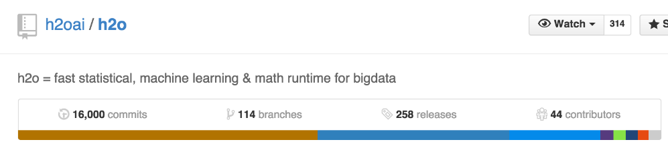
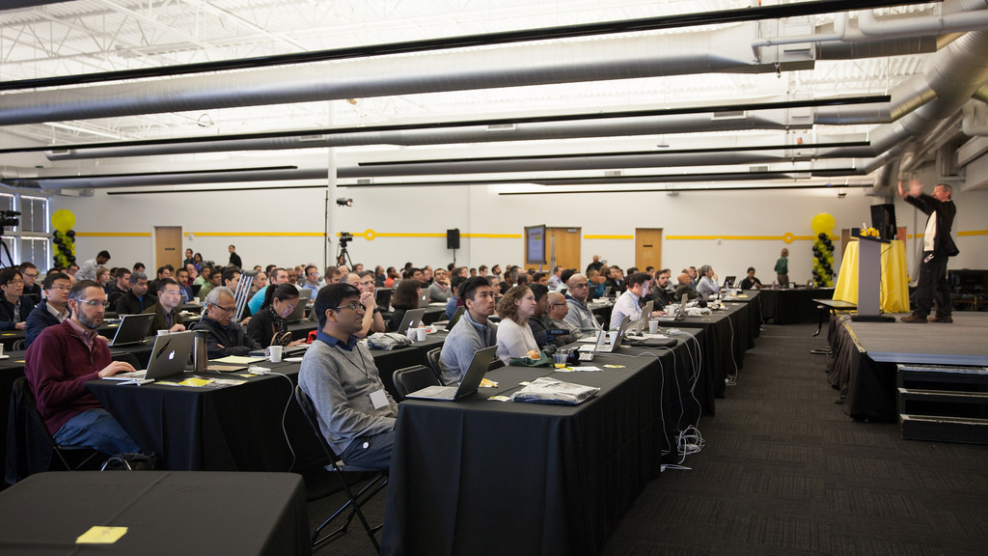
Team Work @ H2O.ai
25,000 commits / 3yrs
H2O World Conference 2014
Join H2O World Nov 9-11 2015!
28

Slide 5
What is H2O?
Math Platform
Open source in-memory prediction engine
Parallelized and distributed algorithms making the most use out of multithreaded systems
GLM, Random Forest, GBM, Deep Learning, etc.
API
Easy to use and adopt
Written in Java – perfect for Java Programmers
REST API (JSON) – drives H2O from R, Python, Excel, Tableau
Big Data
More data? Or better models? BOTH
Use all of your data – model without down sampling
Run a simple GLM or a more complex GBM to find the best fit for the data
More Data + Better Models = Better Predictions
H₂O.ai Machine Intelligence

Slide 6
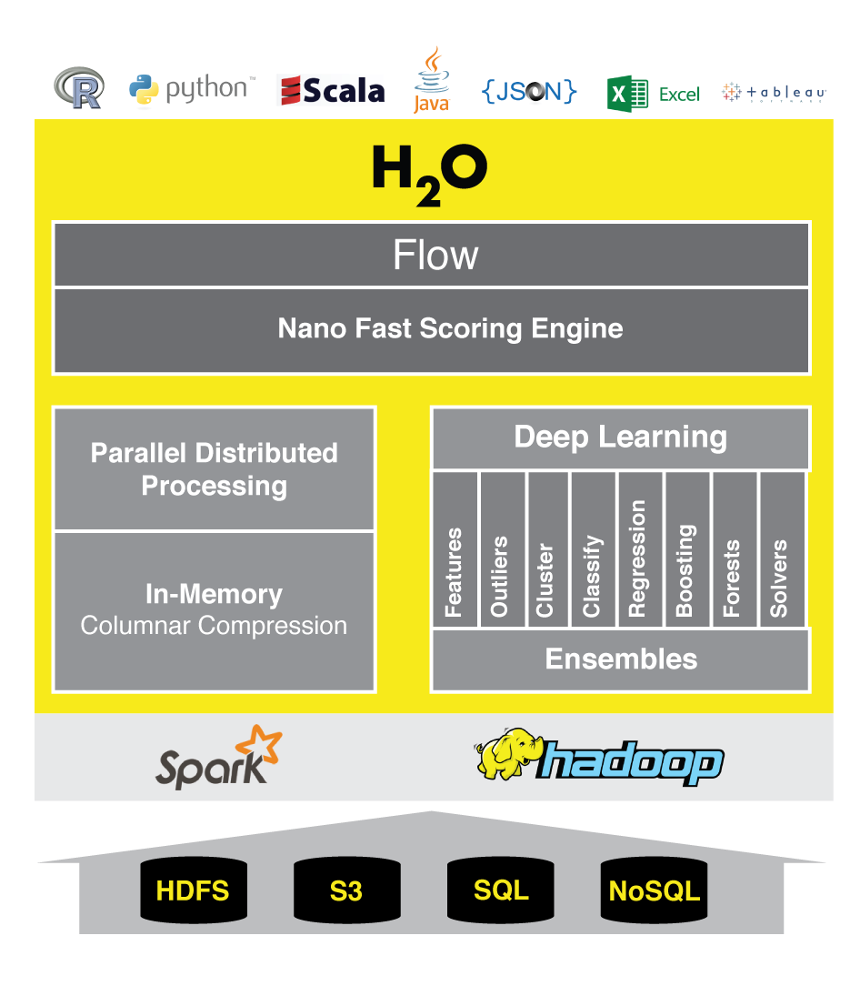
Accuracy with Speed and Scale

Slide 7
H2O Software Stack
Customer Algorithm
JavaScript
R
Python
Excel/Tableau
Flow
Network
Rapids Expression Evaluation Engine
Customer Algorithm
Scala
GLM
GBM
RF
Deep Learning
K-Means
PCA
Parse
In-H2O Prediction Engine
Customer Algorithm
Fluid Vector Frame
Job
Distributed K/V Store
MRTask
Non-blocking Hash Map
Fork/Join
Spark
Hadoop
Standalone H2O

Slide 8

Reading Data from HDFS into H2O with R
STEP 1
h2o_df = h2o.importFile(“hdfs://path/to/data.csv”)
R user

Slide 9
Reading Data from HDFS into H2O with R
STEP 2
2.3
Initiate distributed ingest
H2O Cluster
2.2
R
HTTP REST API request to H₂O
has HDFS path
H₂O
H₂O
h2o.importFile()
H₂O
2.1
R function call
2.4
Request data from HDFS
HDFS
data.csv
Notes:
Data never goes into or through R
R tells H2O what to do
R has a pointer to the big data that lives in H2O
Operations on the R object are intercepted using operator overleading and forwarded to H2O via the REST API
H2OFrame object in R is a proxy for the big data in H2O
R: df= H2O.imporrtFile(“hdfs://path/to/data.csv”)
h2o>_df is an H2OFrame object in R

Slide 10
Reading Data from HDFS into H2O with R
STEP 3
3.2
Distributed H₂O
Frame in DKV
H2O Cluster
3.3
R
h2o_df
Return pointer to data in REST API JSON Response
H₂O
H₂O
Frame
H₂O
Cluster IP
Cluster Port
Pointer to Data
H₂O
3.4
h2o_df object created in R
3.1
HDFS provides data
HDFS
data.csv
Notes:
Data never goes into or through R
R tells H2O what to do
R has a pointer to the big data that lives in H2O
Operations on the R object are intercepted using operator overleading and forwarded to H2O via the REST API
H2OFrame object in R is a proxy for the big data in H2O
R: df= H2O.imporrtFile(“hdfs://path/to/data.csv”)
h2o>_df is an H2OFrame object in R

Slide 11
R Script Starting H2O GLM
TCP/IP
HTTP
HTTP
Legend
REST/JSON
REST/JSON
/3/ModelBuilders/glm endpoint
Network layer
.h2o.startModelJob()
POST /3/ModelBuilders/glm
Job
REST layer
GLM algorithm
H2O - algos
h2o.glm()
GLM tasks
H2O - core
R script
Fork/Join framework
K/V store framework
User process
Standard R process
H2O process
H2O process

Slide 12
R Script Retrieving H2O GLM Result
TCP/IP
HTTP
HTTP
Legend
REST/JSON
REST/JSON
/3/Models endpoint
Network layer
h2o.getModel()
GET /3/Models/glm_model_id
REST layer
H2O - algos
h2o.glm()
H2O - core
R script
Fork/Join framework
K/V store framework
User process
Standard R process
H2O process
H2O process

Slide 13
Step 1
Download and install h2o: h2o.ai, hit download button
SL Guest, password SerendipityOSW
Only requirement is JDK 1.7+
plus required packages if using R or Python
Pick R, Python (2.7.x), or Standalone for tonight

Slide 14
Step 2
http://bit.ly/1SNkmFa­
Contains training and validation data, starter R and Python scripts
Unzip chicago.zip

Slide 15
Thank You
(final holdout test set for Chicago Meetup is at https://s3.amazonaws.com/0xdata-public/hank/mikeditka.csv)
Thank you Chicago for a great time!

